Slide 1
SDR on Linux for the Noob
Full Spectrum Cyber

Slide 2
Software Defined Radio
Radio components such as modulators, demodulators and tuners are traditionally implemented in hardware components.
The advent of modern computing allows most of these traditionally hardware based components to be implemented into software instead.
Hence, the term software defined radio. This enables easy signal processing and thus cheap wide band scanner radios to be produced.
http://www.rtl-sdr.com/about-rtl-sdr/

Slide 3
Speak Easy
the SpeakEasy project was started in 1991 and was the first large-scale software radio. SpeakEasy was motivated in large part by the communications interoperability problems that resulted from different branches of the military services having dissimilar (non-interoperable) radio systems. This lack of communications interoperability can be directly linked to casualties in several conflicts. SpeakEasy had a very aggressive goal of implementing ten different radio waveforms in software on a single platform. The designers chose the fastest DSP available at the time, the Texas Instruments TMS320C40 processor, which ran at 40 MHz. Since this was not enough processing power to implement all of the waveform processing, the system boards were designed to each support four ’C40s as well as some FPGAs.
In 1994, Phase I was successfully demonstrated; however it involved several hundred processors and filled the back of a truck. Moore’s Law provides a doubling in speed every eighteen months, and since it had taken three years to build the system and write all of the software, two doublings had taken place. This seemed to indicate that the number of processors could be reduced by a factor of four. However, SpeakEasy could not take advantage of these newer faster processors, and the reason was the software.
https://en.wikipedia.org/wiki/SpeakEasy

Slide 4
RTL-SDR
RTL-SDR is a very cheap software defined radio
uses a DVB-T TV tuner dongle
based on the RTL2832U chipset.
the signal I/Q data could be accessed directly,
via a new software driver.
creating a wideband software defined radio
combined efforts of Antti Palosaari, Eric Fry and Osmocom
circa 2012
http://www.rtl-sdr.com/about-rtl-sdr/

Slide 5
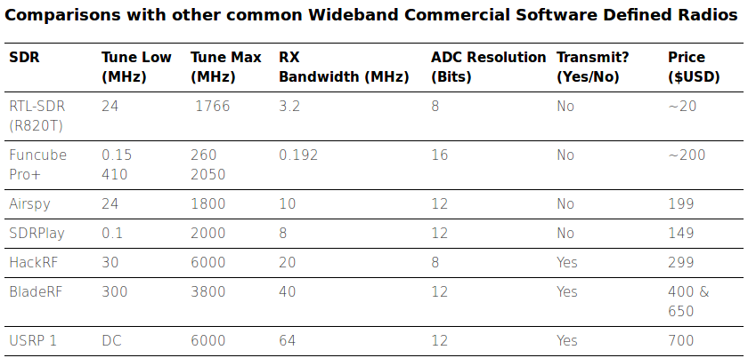
Common SDR Device Table
http://www.rtl-sdr.com/about-rtl-sdr/

Slide 6

Multiple Domains for C4ISR
C4ISR
LAND
SEA
AIR
SPACE
CYBER

Slide 7
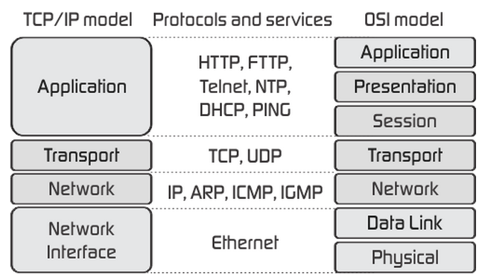
OSI and TCP/IP Models

Slide 8
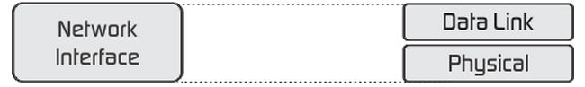
OSI and TCP/IP Models
?
IEEE 802.3 Ethernet
IEEE 802.11 WiFi
GSM/GPRS Cell Phones
LTE/EPC Cell Phones
AX.25 PacketRadio, APRS
Custom RF

Slide 9






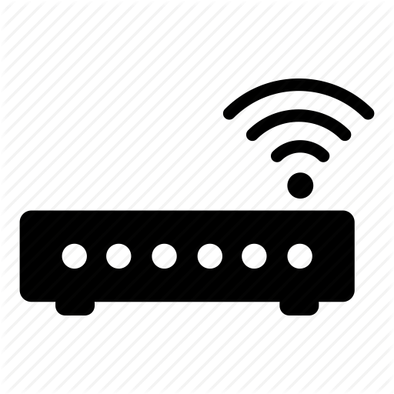


Multi Domain Data Transport

Slide 10









Multi Domain Situation Awareness
ADS-B, ACARS
APRS
AIS
GSM, LTE
ATCS, ATOS
802.11
GPredict
FRS/GMRS
P25 Digital Voice
NOAA APT
POCSAG
GPS

Slide 11


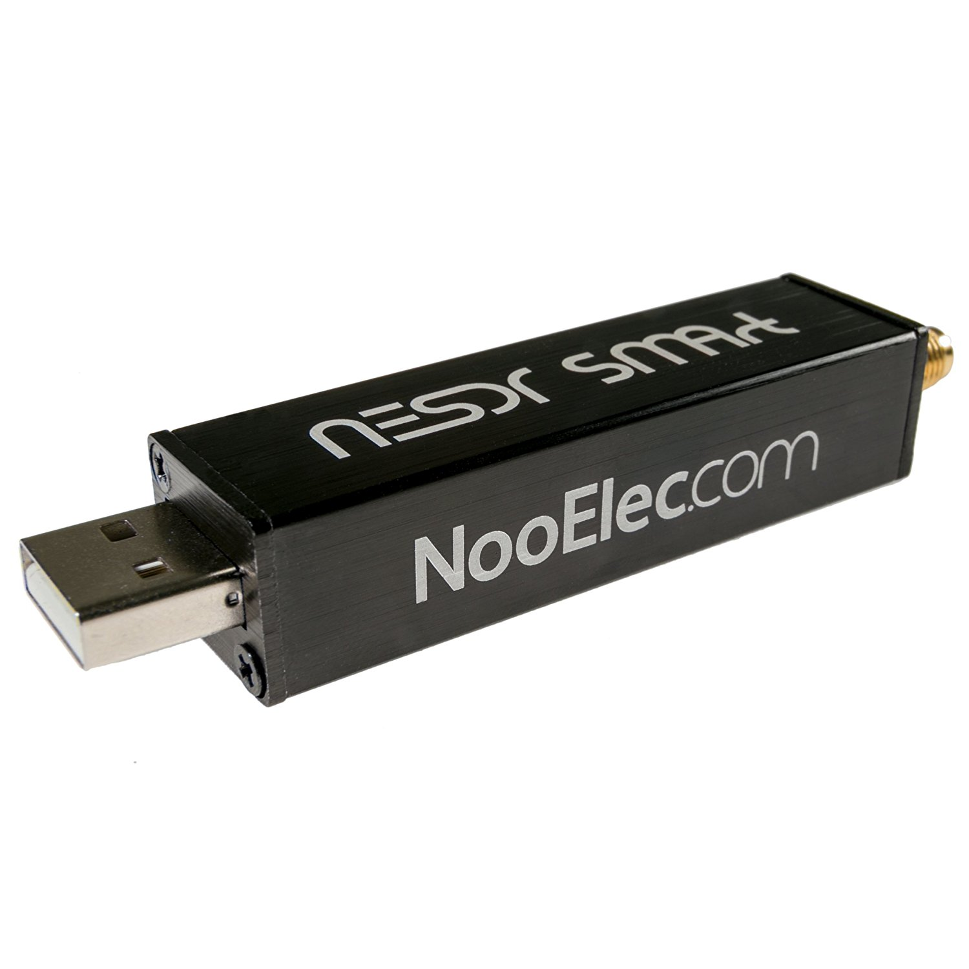
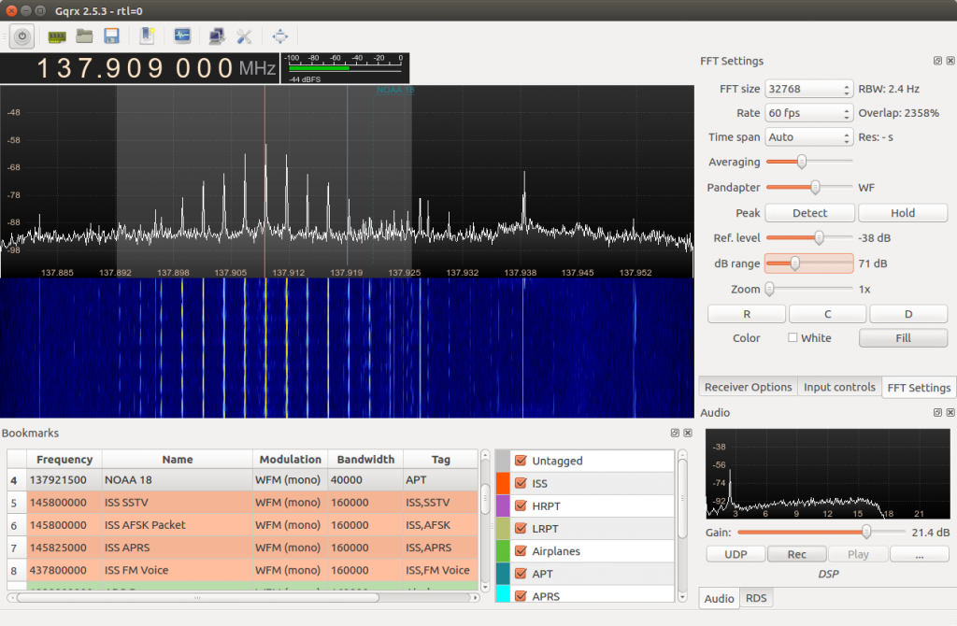
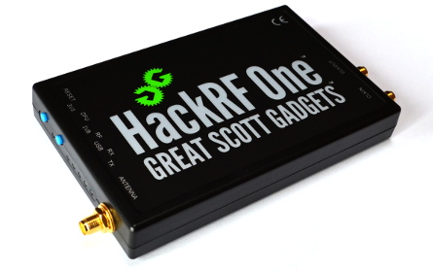
SDR Architecture
Antenna | Cable (RG-48) (SMA) | SDR Device (USB) | Host Computer | Application Software

Slide 12
Devices

Slide 13
SDR Device: RTL-SDR
RTLSDR_PCB
Cost: $10 – 22 USD
Frequency Range: approx. 24 MHz – 1766 MHz
(below 24 MHz available on RTL-SDR.com V3 dongles)
ADC Resolution: 8 Bits
Max Bandwidth: 3.2 MHz / 2.4 or 2.8 MHz max stable.
TX/RX: RX Only
$40 Low Frequency (>100KHz) via Ham It Up
$40Extended Versions 65MHz-2300MHz
https://www.amazon.com/NooElec-NESDR-SMArt-Enclosure-R820T2-Based/dp/B01GDN1T4S
http://www.rtl-sdr.com/roundup-software-defined-radios/

Slide 14
SDR Device: HackRF One
$300
half-duplex transceiver
operating freq: 1 MHz to 6 GHz
supported sample rates: 2 Msps to 20 Msps (quadrature)
resolution: 8 bits
interface: High Speed USB (with USB Micro-B connector)
power supply: USB bus power
software-controlled antenna port power (max 50 mA at 3.3 V)
SMA female antenna connector (50 ohms)
SMA female clock input and output for synchronization
convenient buttons for programming
pin headers for expansion
portable
open source
https://github.com/mossmann/hackrf/wiki/HackRF-One

Slide 15
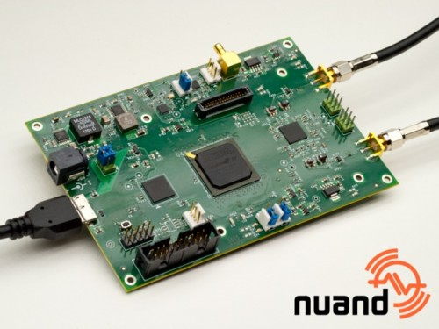
SDR Device: BladeRF
Cost:
$420 USD (x40), $650 USD (x115)
Frequency Range:
300 MHz – 3.8 GHz
ADC Resolution: 12 Bits
Max Bandwidth: 28 MHz
TX/RX: TX and RX (Full Duplex)
Preselectors: None
http://www.rtl-sdr.com/roundup-software-defined-radios/

Slide 16
Setups

Slide 17
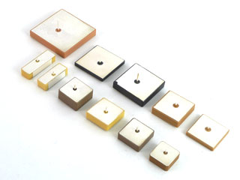
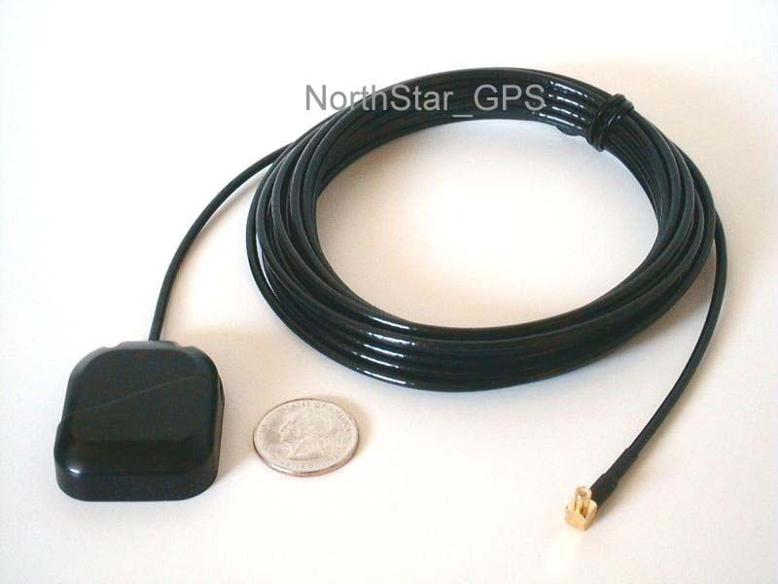
GPS
Antenna:
Ceramic 1” square
Bias-T (5V)
Frequencies:
1575.42 MHz
Software:
gnss-sdr
Notes:
User front-end-cal as test tool

Slide 18
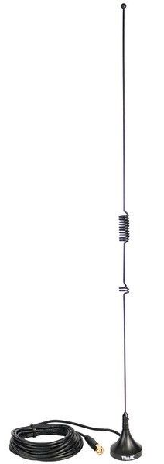
ADSB: dump1090
Antenna:
70cm/2m (?)
Frequencies:
1575.42 MHz
Software:
dump1090
--net
Http:8080
Http:3000x data
--interactive
Issues:
with directory structure
Gmap.html and binary in same dir
Notes:
dump1090 --net --interactive
Open browser to http://localhost:8080

Slide 19
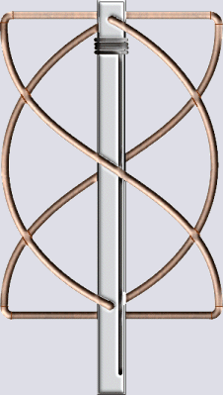
NOAA APT
Automatic Picture Transmission
Antenna:
QFH for Satellites
Frequencies:
NOAA 15: 137.620
NOAA 18: 137.9125
NOAA 19: 137.100
Software:
gpredict + gqrx + wxtoimg
virtual audio cable

Slide 20
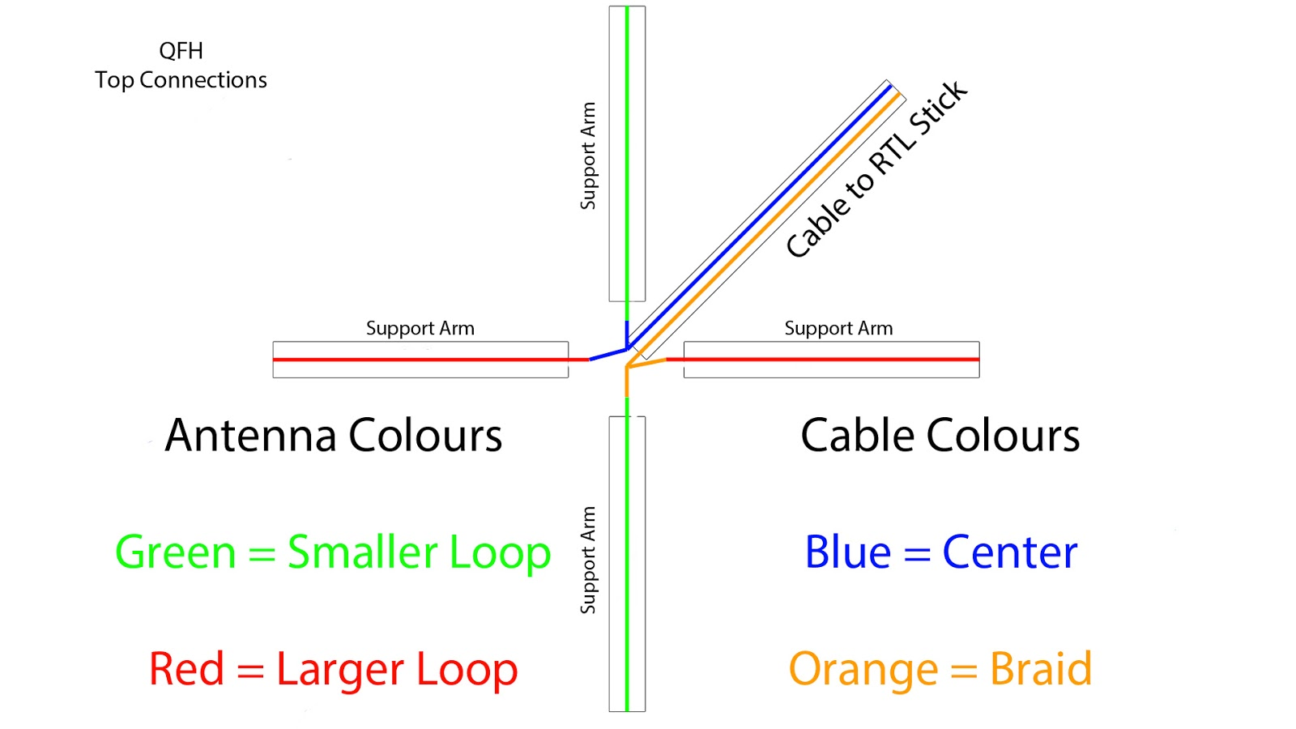
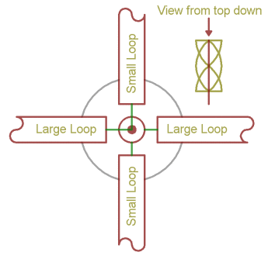
Antenna: QHF
http://jcoppens.com/ant/qfh/calc.en.php
http://www.g4ilo.com/qfh.html
http://www.instructables.com/id/NOAA-Satellite-Signals-with-a-PVC-QFH-Antenna-and-/
https://sdrsatellitesounds.wordpress.com/2015/04/14/building-a-easy-to-make-homemade-qfh-antenna-from-coax/

Slide 21
APRS
Antenna:
70cm/2m
Frequencies:
1575.42 MHz
Software:
rtl_fm
mutimon
xastir
Issues:
rtl_fm -M fm -f 929.77M -s
Notes:
mkfifo -m a=rw aprs.fifo
rtl_fm -f 144.390M -s 22050| \
multimon-ng -t raw -a AFSK1200 -f alpha -A /dev/stdin \
> /tmp/aprs.fifo
#--------script--------
# this reads from rlt_fm pipe
# into xastir client which xastir server gui then collects
#-----------------------
#!/bin/bash
MYCALL=my_call_sign
MYPASS=my_callpass_code
PIPE=/tmp/aprs.fifo
while true
do
if read line <$PIPE; then
echo $line
if [[ $line == APRS* ]]; then
xastir_udp_client localhost 2023 $MYCALL $MYPASS "${line:6}"
fi
fi
done
#-----------------------
Over in xastir you need to turn on "Enable Server Ports" in the Interface menu, make sure you're firwalled as xastir will start accepting packets from anyone who can authenticate using the basic callpass algorithm

Slide 22
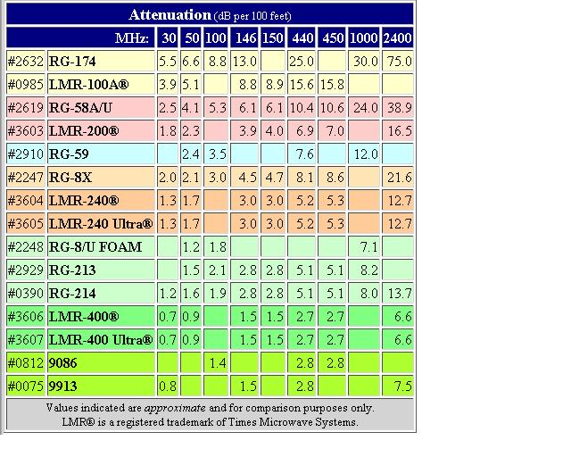
Coax Attenuation Chart
http://z1.ifrm.com/2510/101/0/p1028694/RGcoax.jpg

Slide 23
Configurations

Slide 24
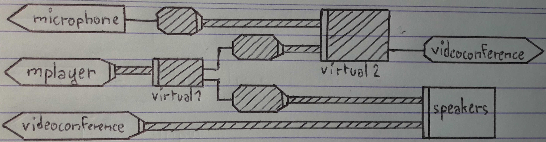
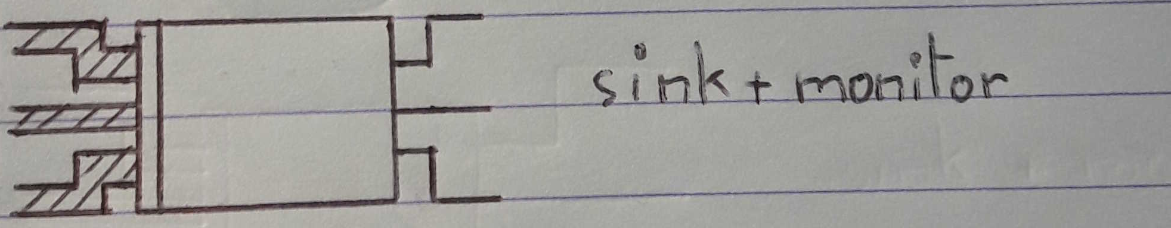
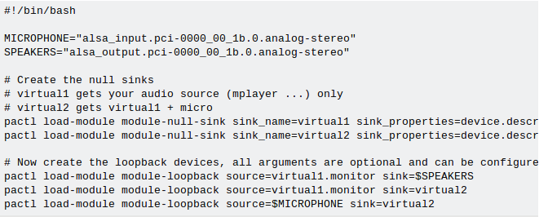
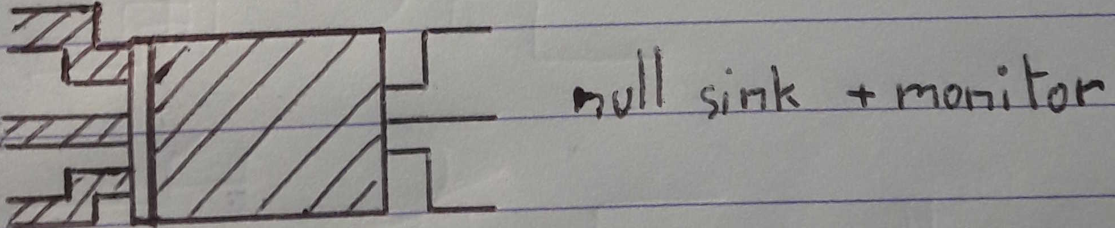
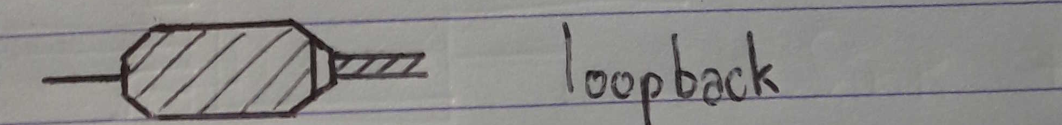
Audio Loopback: Software
See full script in notes
https://github.com/toadjaune/pulseaudio-config
Notes:
!/bin/bash
# This script sets up pulseaudio virtual devices
# The following variables must be set to the names of your own microphone and speakers devices
# You can find their names with the following commands :
# pacmd list-sources
# pacmd list-source-outputs
# Use pavucontrol to make tests for your setup, and to make the runtime configuration
# Route you audio source to virtual1
# Record your sound (videoconference) from virtual2.monitor
MICROPHONE="alsa_input.pci-0000_00_1b.0.analog-stereo"
SPEAKERS="alsa_output.pci-0000_00_1b.0.analog-stereo"
# Create the null sinks
# virtual1 gets your audio source (mplayer ...) only
# virtual2 gets virtual1 + micro
pactl load-module module-null-sink sink_name=virtual1 sink_properties=device.description="virtual1"
pactl load-module module-null-sink sink_name=virtual2 sink_properties=device.description="virtual2"
# Now create the loopback devices, all arguments are optional and can be configured with pavucontrol
pactl load-module module-loopback source=virtual1.monitor sink=$SPEAKERS
pactl load-module module-loopback source=virtual1.monitor sink=virtual2
pactl load-module module-loopback source=$MICROPHONE sink=virtual2
# If you struggle to find the correct values of your physical devices, you can also simply let these undefined, and configure evrything manually via pavucontrol
# pactl load-module module-loopback source=virtual1.monitor
# pactl load-module module-loopback source=virtual1.monitor sink=virtual2
# pactl load-module module-loopback sink=virtual2

Slide 25
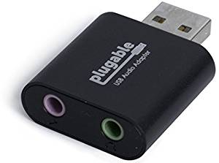
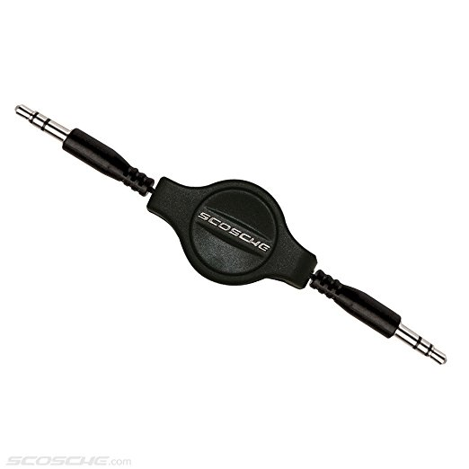
Audio Loopback: Hardware
Notes:
https://github.com/toadjaune/pulseaudio-config

Slide 26
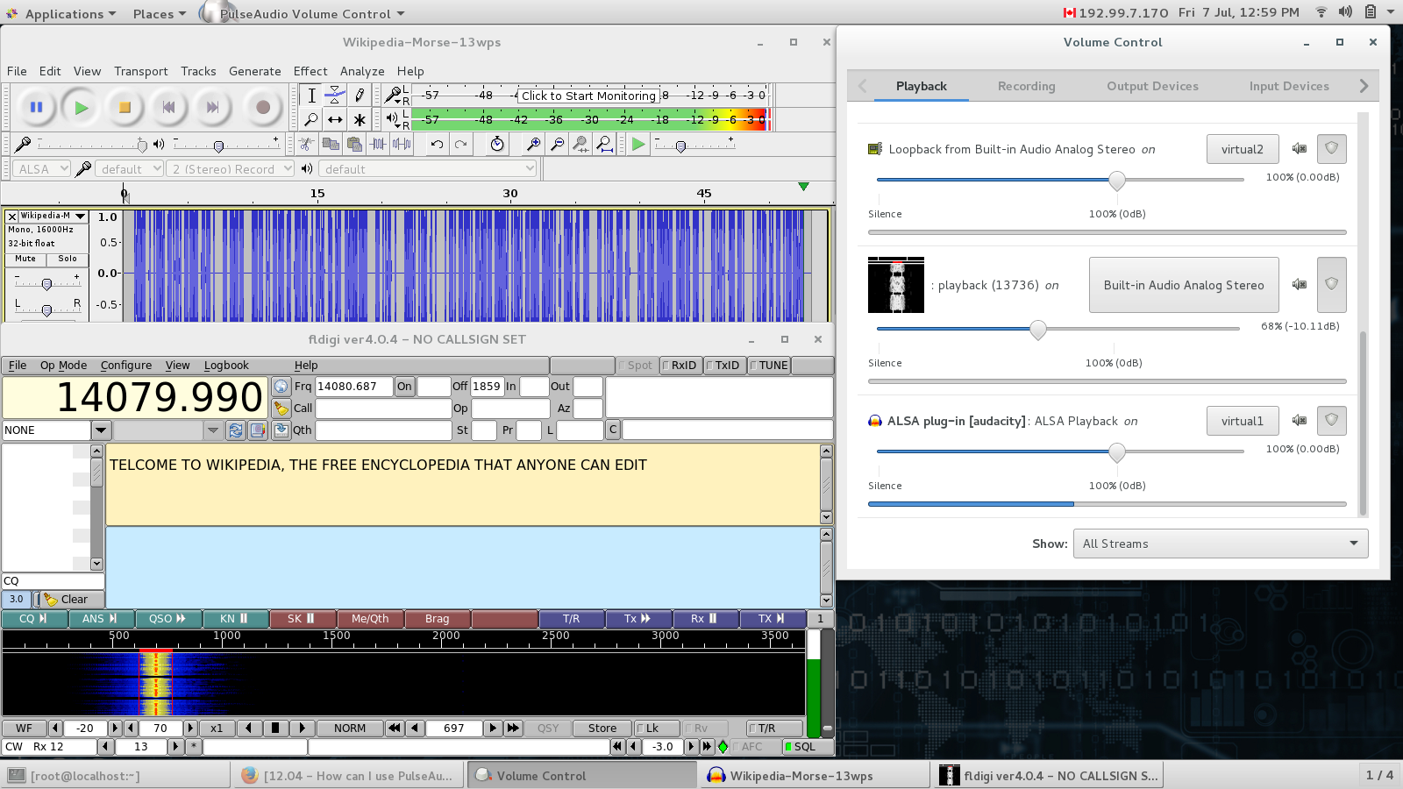
Audio Loop Back: Morse Code Test Rig
This is a non-radio test rig to test virtual audio loopback configuration
[ Wiki-Morse.ogg > audacity > virtual sink > virtual source > fldigi ]
Sinks and Sources defined via script
Sinks and sources wired via pavucontrol

Slide 27
Software

Slide 28
SW: GNU Radio
GNU Radio is a signal-processing package and part of the GNU Project. It is distributed under the terms of the GNU General Public License (GPL), and most of the project code is copyrighted by the Free Software Foundation[2]
First published in 2001,

Slide 29
FM 3-12 provides overarching doctrinal guidance and direction to the Army for conducting cyberspace and electronic warfare (EW) operations using cyberspace electromagnetic activities (CEMA) in unified land operations.
Cyberspace and EW operations are integrated into operations using already established joint and Army processes such as the intelligence process, targeting, and the military decision-making process (MDMP).

Slide 30
SW: Freqwatch
Requires a mysql/mariadb backend
Configure freqwatch.conf
Runs rtl_power over freq range at given step
Dumps data into database
Older software now replaced by ‘gamma rt”

Slide 31
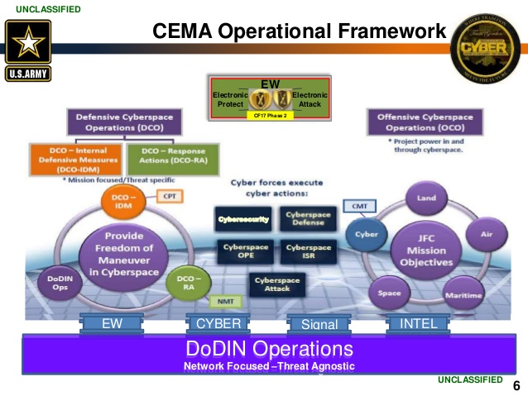

Slide 32
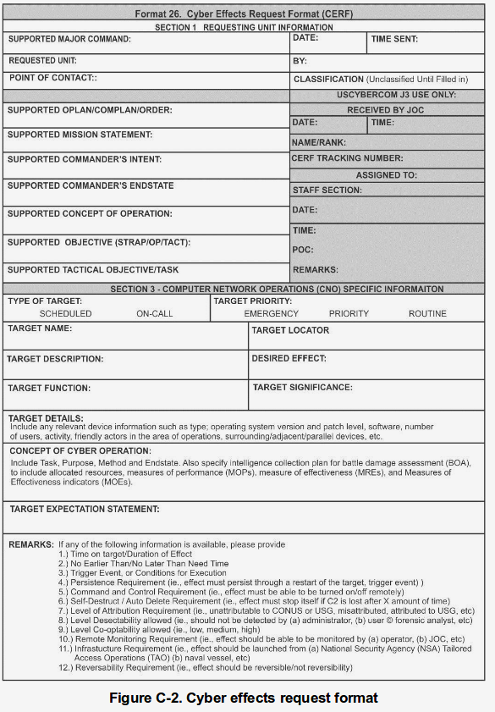
FM3-12: Cyber Effects Request Form
CERF

Slide 33
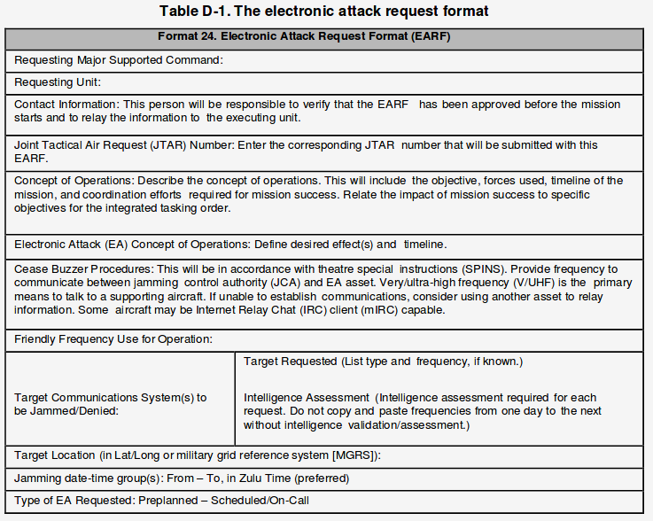
FM3-12: Electronic Attack Request Form
EARF

Slide 34
Backup Slides

Slide 35
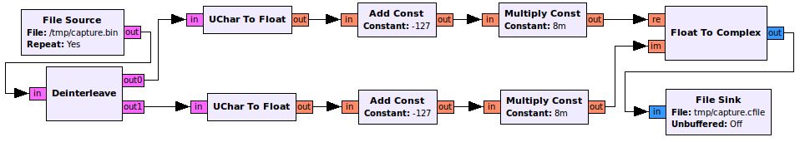
http://osmocom.org/projects/sdr/wiki/rtl-sdr

Slide 36
Front-end-cal
Starting gps coordinates
Sample freq

Slide 37
blacklist dvb_usb_rtl28xxu
blacklist rtl2832
blacklist rtl2830
Modprope -r dvb_usb_rtl28xxu

